Slide 1
Dev relax
STRESS DETECTING AND RELIEVING APPLICATION

Slide 2

introduction
DevRelax is a desktop application designed and developed using machine learning technologies to detect and assist in relieving users stress levels and alleviating emotions.
GOAL: Early detection of stress levels and providing assistance in relieving it.

Slide 3
KEYSTROKE DYNAMIC BASED STRESS DETECTION

Slide 4
Background and literature
Stress detection via keystroke dynamics may seem not possible. However, several research studies prove otherwise. Also, there were some limitations in some of the existing literature. To summarize a few,
Paper [1]: They used a pressure-sensitive keyboard to measure user stress levels by analyzing keypress pressure.
Paper [2]: They induced stress in controlled settings and monitored physiological factors while collecting keystroke data with an Apple keyboard.
Paper [3]: They induced stress through time pressure and used controlled lab experiments, measuring it through text lengths, language complexity, and similar factors.
Paper [4]: They detected user emotions and induced stress using pressure-sensitive keyboards in controlled environments where users were given instructions on what to do.
Paper [5]: They induced stress artificially and analyzed it by examining typing and behavioral patterns.
IT20020262 | PERERA M. S. D | TMP_2023_139

Slide 5


Background and literature
VISUALIZATION OF THE RESEARCH GAP
Research | [1] | [2] | [3] | [4] | [5] | Proposed Component
Compatible With Any Keyboard
Functional Without Various Bio-sensors
Free From Artificial Stress Induction
Adaptable To Everyday Use
IT20020262 | PERERA M. S. D | TMP_2023_139

Slide 6
RESEARCH PROBLEM
Can Stress Levels Be Detected By Analyzing Keystroke Dynamics?
It Is Something That Is Unique To Each User Therefore, How To Predict Each Users Stress Level?
objectives
Train a machine learning model to predict stress levels.
Develop a program to monitor and log keystroke dynamics related data.
Configure the data communication strategy between the program and model.
Utilize an Incremental learning based approach to retrain and finetune the trained model.
Integrate the component with the desktop application.
IT20020262 | PERERA M. S. D | TMP_2023_139

Slide 7
Progress Presentation 1 – 50%
KEYLOGGER
ML MODEL
APPLICATION
LITERATURE
KEYSTROKE DYNAMICS
MODEL SELECTION
APP INTEGRATION
RESEARCH PAPER
0%
50%
90%
100%
IT20020262 | PERERA M. S. D | TMP_2023_139

Slide 8
Progress Presentation 2 – 95%
KEYLOGGER
ML MODEL
APPLICATION
LITERATURE
KEYSTROKE DYNAMICS
MODEL SELECTION
APP INTEGRATION
RESEARCH PAPER
0%
50%
90%
100%
95%
IT20020262 | PERERA M. S. D | TMP_2023_139

Slide 9
RESEARCH PAPER
PAPER TITLE:
An Incremental Learning Approach Towards Keystroke Dynamic Based Stress Detection for IT Professionals
CONFERENCES PUBLISHED IN:
5TH INTERNATIONAL CONFERENCE ON ADVANCEMENTS IN COMPUTING (ICAC 2023)
INTERNATIONAL CONFERENCE IN DATA SCIENCE (ICDS 2023)
IT20020262 | PERERA M. S. D | TMP_2023_139

Slide 10
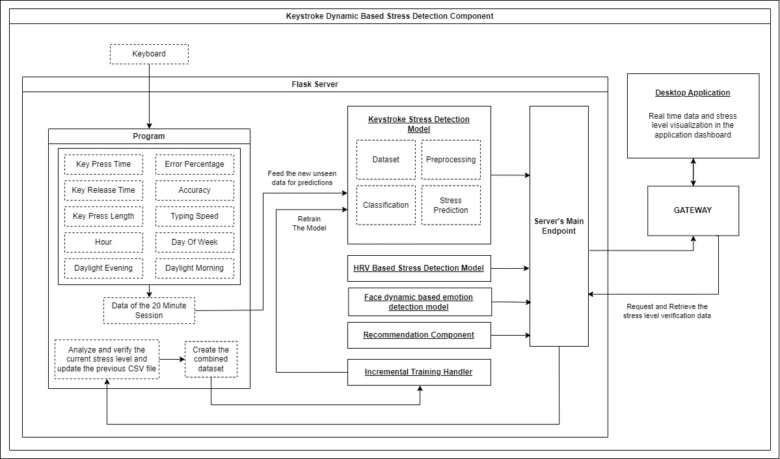
Workflow of the component
IT20020262 | PERERA M. S. D | TMP_2023_139

Slide 11
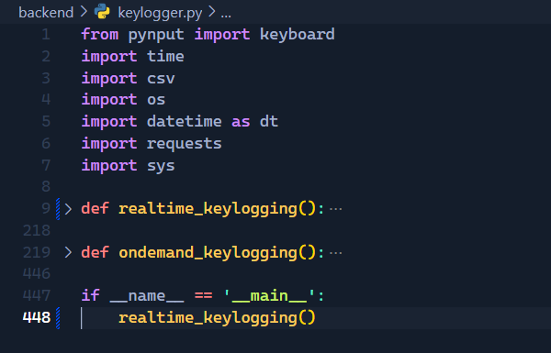
Methodology
The Random Forest model is trained and is hosted in the Flask server.
The Keylogger program defines 2 functions.
One for Realtime Keylogging
The other one is for On-demand Keylogging
The Keylogger program is triggered in the flask server along with the ML model.
IT20020262 | PERERA M. S. D | TMP_2023_139

Slide 12
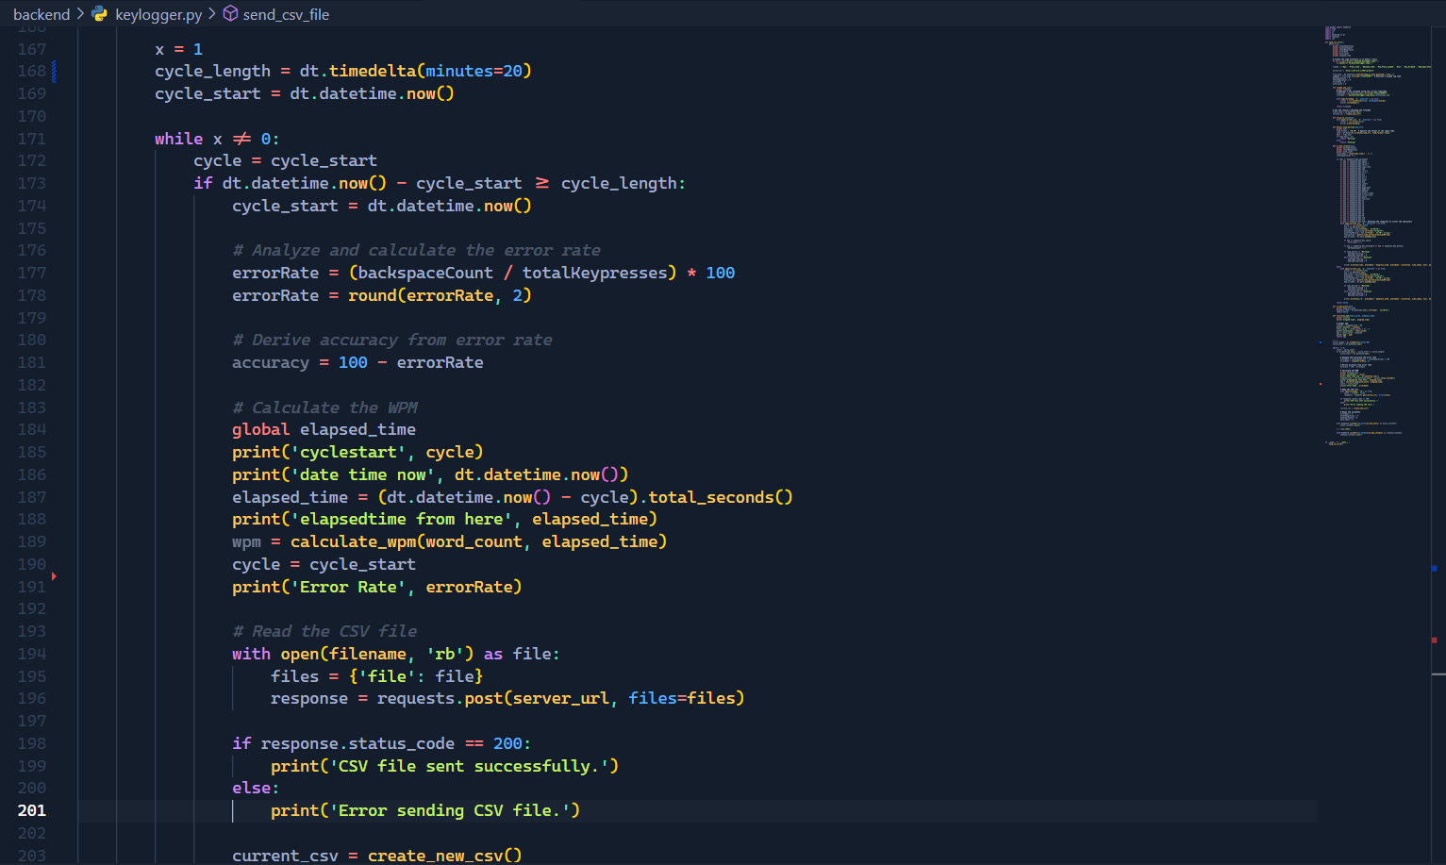
Methodology
The program saves each 20 minute session keystroke data to a CSV file and sends to the ML model hosted in the server.
IT20020262 | PERERA M. S. D | TMP_2023_139

Slide 13
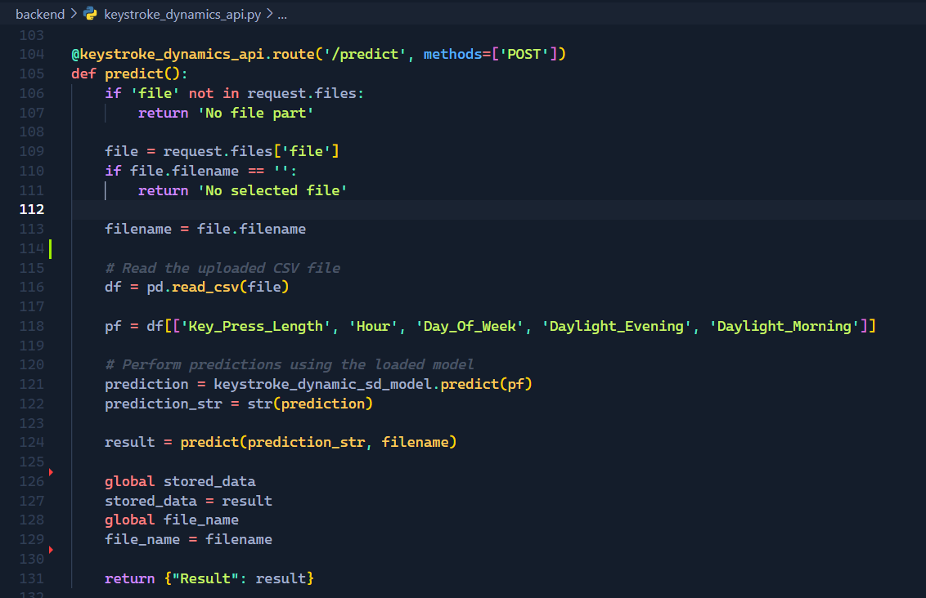
Methodology
The ML model will acquire the CSV file and analyze data and predict the stress level based on that data.
The prediction will sent to the Application.
IT20020262 | PERERA M. S. D | TMP_2023_139

Slide 14
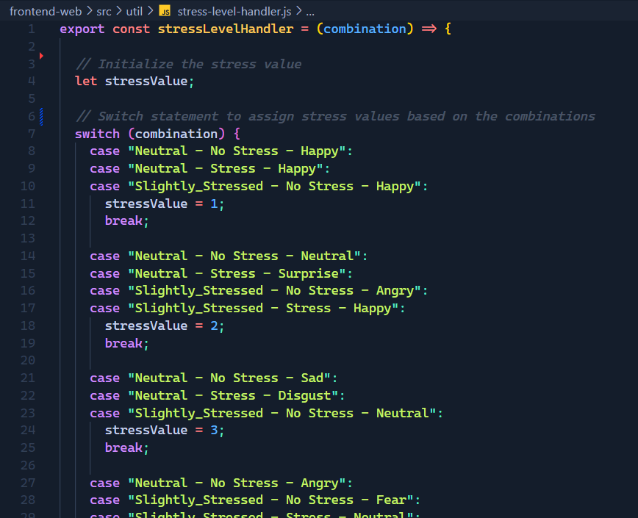
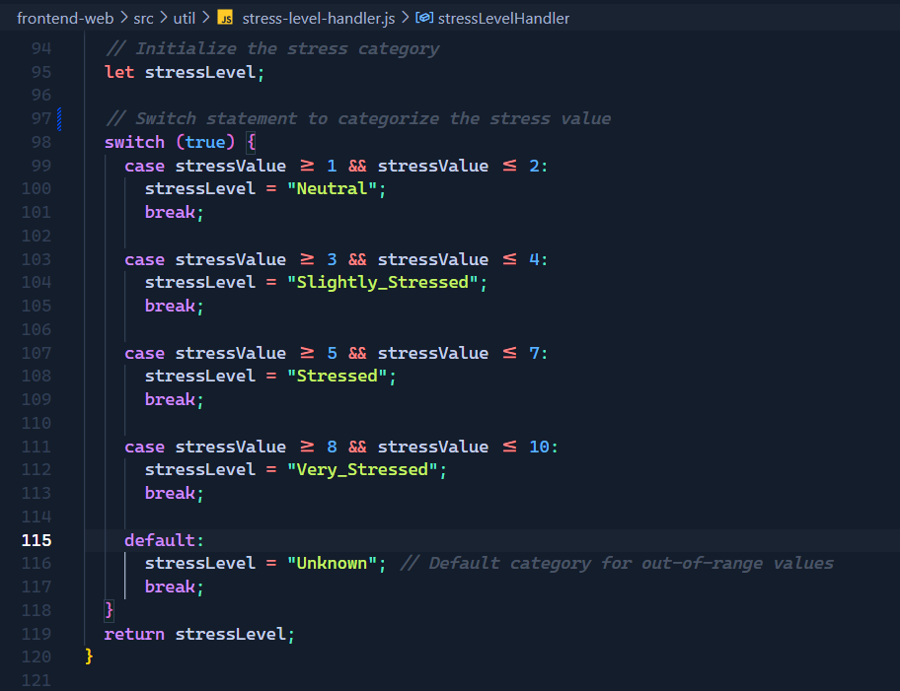
Methodology
The prediction result will be aggregated with the other 2 component prediction results (HRV based stress detection component and the Facial Dynamics based Emotion Detection component) that were generated during the same 20 minute session and output a Aggregated Stress Level. The Hypothesis for this will be explained in the later slides
IT20020262 | PERERA M. S. D | TMP_2023_139

Slide 15
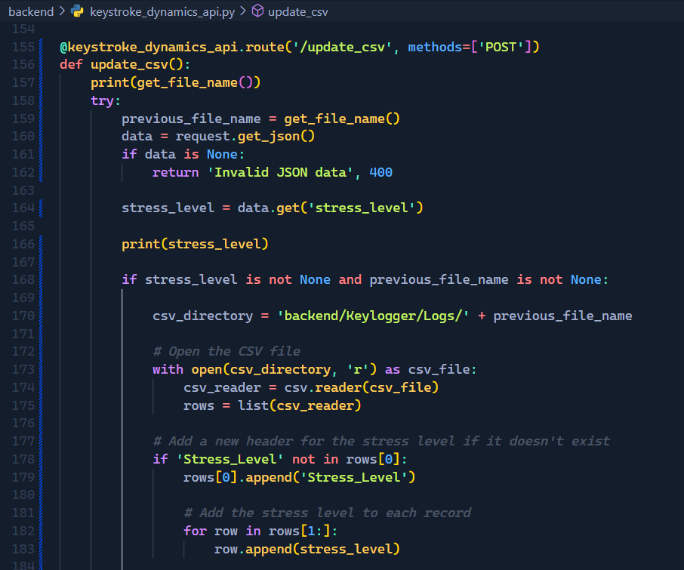
Methodology
The Aggregated stress level will then be sent back to the Flask server. Then the CSV file that was used to predict the stress level will be updated with the Aggregated Stress Level making the CSV file ready for the model retraining.
IT20020262 | PERERA M. S. D | TMP_2023_139

Slide 16
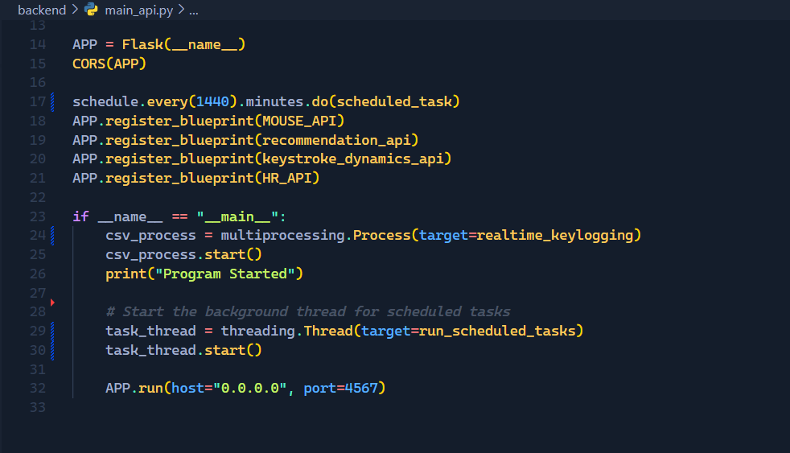
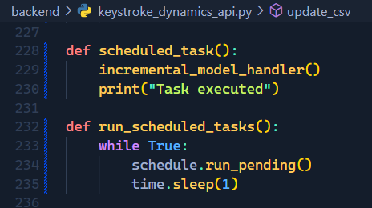
Methodology
A scheduled job will run every 24 hours to retrain the current model. Then the pretrained model accuracy and the newly retrained model accuracy will be compared.
The new model will be assigned as the base model if the accuracy is equal or greater than the previous model. Else the previous model will continue as the base model until the next re-training session.
IT20020262 | PERERA M. S. D | TMP_2023_139

Slide 17
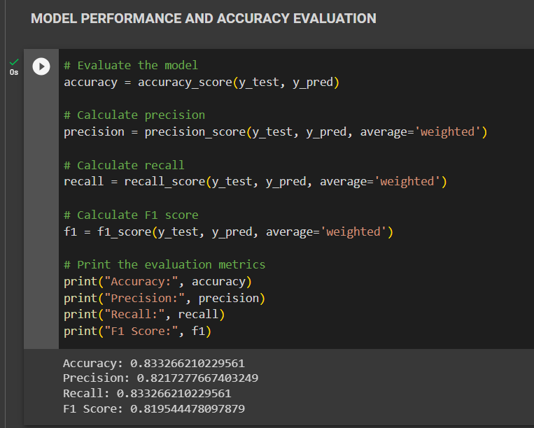
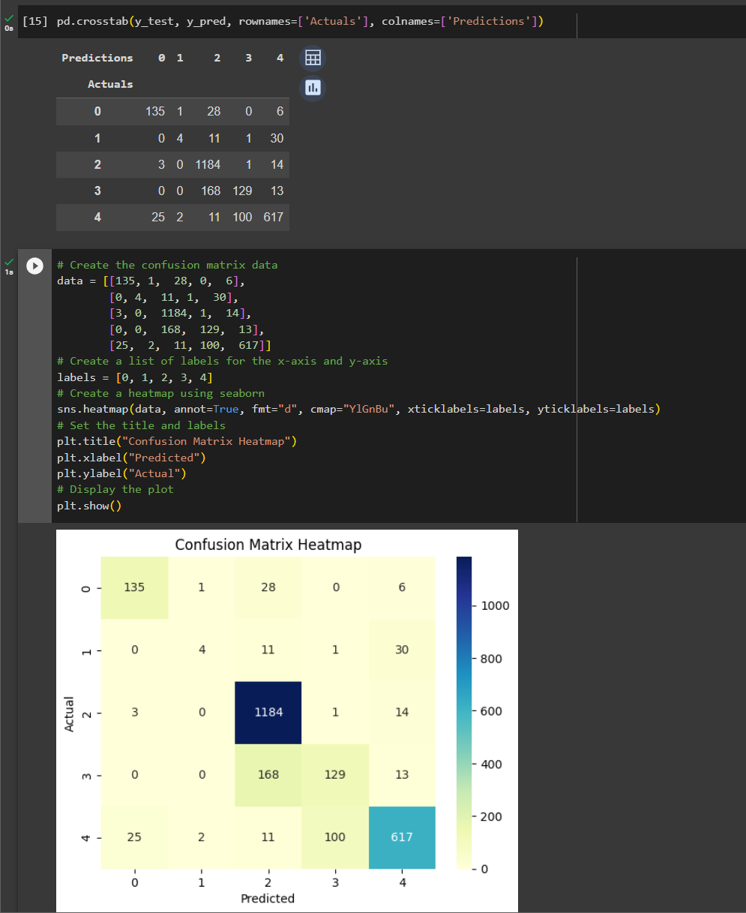
Results and discussion
RANDOM FOREST MODEL WITHOUT OVERSAMPLING
IT20020262 | PERERA M. S. D | TMP_2023_139

Slide 18
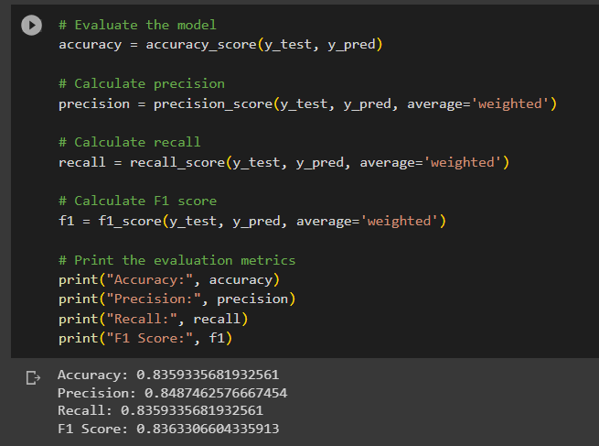
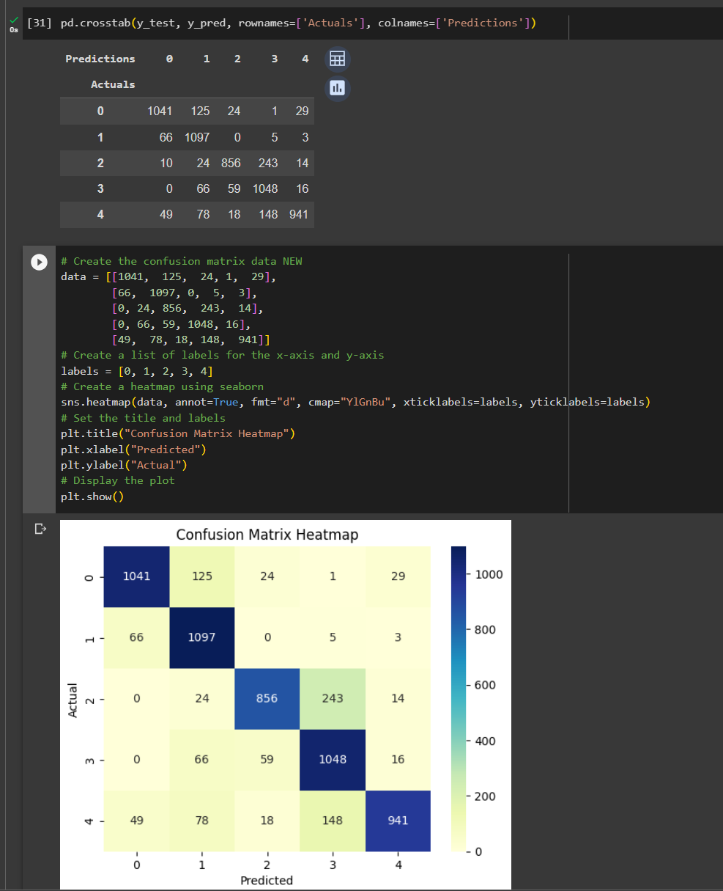
Results and discussion
RANDOM FOREST MODEL AFTER OVERSAMPLING
IT20020262 | PERERA M. S. D | TMP_2023_139

Slide 19
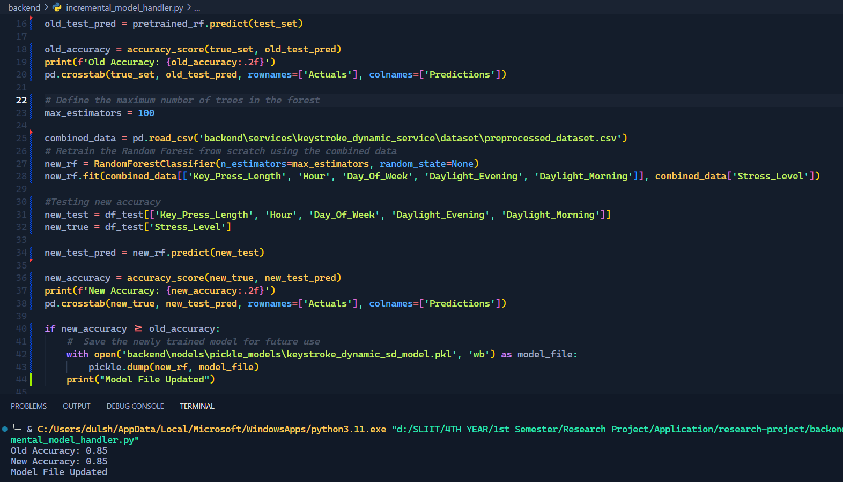
Results and discussion
INCREMENTAL HANDLER RESULTS
IT20020262 | PERERA M. S. D | TMP_2023_139

Slide 20
Panel suggestion
The suggestion received from the panel with regards to the component was to acquire mobile touch dynamics along with the keyboard dynamics and predict the stress levels based on both acquired dynamics and get an aggregated prediction.
The approach to integrate the suggestion to the component would be to,
Develop a mobile application which will run in the background of the mobile device.
Train and host a separate ML model to generate predictions based on the mobile touch dynamics.
Configure endpoints to set up the communication between the mobile application and the Flask server to receive the data generated from the mobile application.
Sync the prediction timer with the keyboard prediction timer of 20mins
Aggregate the predictions generated from,
Keystroke Dynamic Based Stress Detection Model
Mobile Touch Dynamic Based Stress Detection Model
Unfortunately, there was no proper dataset that would be sufficient enough to train the Mobile Touch Dynamic Based Stress Detection Model.
The solution to this issue is to generate a dataset. However, generating such a dataset would consume and require a considerable amount of time and resources.
Therefore, after considering the limited time and resources the suggestion will be considered as a limitation in the current component which will be addressed as a future improvement.
IT20020262 | PERERA M. S. D | TMP_2023_139

Slide 21
REFERENCES
[1] | P. P. A. R. M. C. Javier Hernandez, "Under Pressure: Sensing Stress of Computer Users," p. 10, 2014.
[2] | S.-H. LAU, "STRESS DETECTION FOR KEYSTROKE DYNAMICS," p. 232, 2018.
[3] | A. M. S. Yee Mei Lim, "Detecting Emotional Stress during Typing Task with," p. 10, 2014.
[4] | Z.-L. L. W.-J. Y. J. D. Hai-Rong LV, "EMOTION RECOGNITION BASED ON PRESSURE SENSOR KEYBOARDS," IEEE, p. 4, 2008.
[5] | L. M. Vizer, "Detecting Cognitive and Physical Stress Through Typing Behavior," p. 4, 2009.
[6] | C. WEERASINGHE, "Stress Detection by Keystroke,App & Mouse Changes," [Online]. Available: https://www.kaggle.com/datasets/chaminduweerasinghe/stress-detection-by-keystrokeapp-mouse-changes.
IT20020262 | PERERA M. S. D | TMP_2023_139

Slide 22
HEART RATE VARIABILITY BASED STRESS DETECTION

Slide 23
RESEARCH PROBLEM
How can low-cost IoT devices (ESP32 and MAX30102) be optimized for accurate stress detection in developers via external mouse-based heart rate variability analysis?
What novel algorithms can enhance real-time stress detection for developers using ESP32 and MAX30102 IoT devices in conjunction with an external mouse, and how can these algorithms be applied in developer-centric applications?
PROPOSED SOLUTION
Proposed solution integrates an ESP32 and MAX30102 sensor-equipped mouse prototype with an OLED display to monitor developers' heart rates in real-time. Data is sent to a Flask server for processing.
advanced feature extraction on the heart rate data to improve stress detection accuracy, providing insights into developers' physiological responses during coding tasks.
Collected data, along with extracted features, is stored in MongoDB at 20-minute intervals, creating a rich dataset for analysis.
Utilizing MongoDB data, our solution employs machine learning for stress prediction, helping developers proactively manage their well-being by identifying stress patterns during software development.
IT20037338 | JAYATHILAKE S. M. D. A. R | TMP_2023_139

Slide 24
Progress Presentation 1 – 50%
PROTOTYPE
ML MODEL
APP
LITERATURE
MOUSE PROTOTYPE
MODEL SELECTION
APP INTEGRATION
RESEARCH PAPER
0%
50%
90%
100%
IT20037338 | JAYATHILAKE S. M. D. A. R | TMP_2023_139

Slide 25
Progress Presentation 2 – 90%
PROTOTYPE
ML MODEL
APP
LITERATURE
MOUSE PROTOTYPE
MODEL SELECTION
APP INTEGRATION
RESEARCH PAPER
0%
50%
90%
100%
IT20037338 | JAYATHILAKE S. M. D. A. R | TMP_2023_139

Slide 26
PP1 PANEL SUGGESTIONS
Exclude the section on steganography and focus on explaining how to achieve precise stress prediction using affordable devices.
Emphasize the importance of precise finger placement on the sensor and ensure validation from our external supervisor (psychologist).
IT20037338 | JAYATHILAKE S. M. D. A. R | TMP_2023_139

Slide 27
RESEARCH PAPER
PAPER TITLE:
Accurate Stress Detection for Developers: Leveraging Low-Cost IOT Devices (ESP32 and MAX30102) to Analyze Heart Rate Variability via an External Mouse
CONFERENCES PUBLISHED IN:
5TH INTERNATIONAL CONFERENCE ON ADVANCEMENTS IN COMPUTING (ICAC 2023)
INTERNATIONAL CONFERENCE IN DATA SCIENCE (ICDS 2023)
IT20037888 | RANASINGHE J. D | TMP_2023_139

Slide 28
SENSOR ANALYZING
Sensor Model | Price (LKR) | Accuracy (%) | Sample Rate (Hz) | Power Consumption (mA) | Signal-to-Noice Ration (SNR) | Additional Notes
KY-039 | 165.00 | 85 | 50 | 10 | 30 dB | Compact design
MAX30100 | 550.00 | 90 | 100 | 8 | 35 dB | Low power usage
GY-MAX30102 | 590.00 | 92 | 120 | 9 | 38 dB | High SNR
MAX30102 | 590.00 | 95 | 80 | 7 | 40 dB | Best performance
IT20037338 | JAYATHILAKE S. M. D. A. R | TMP_2023_139

Slide 29
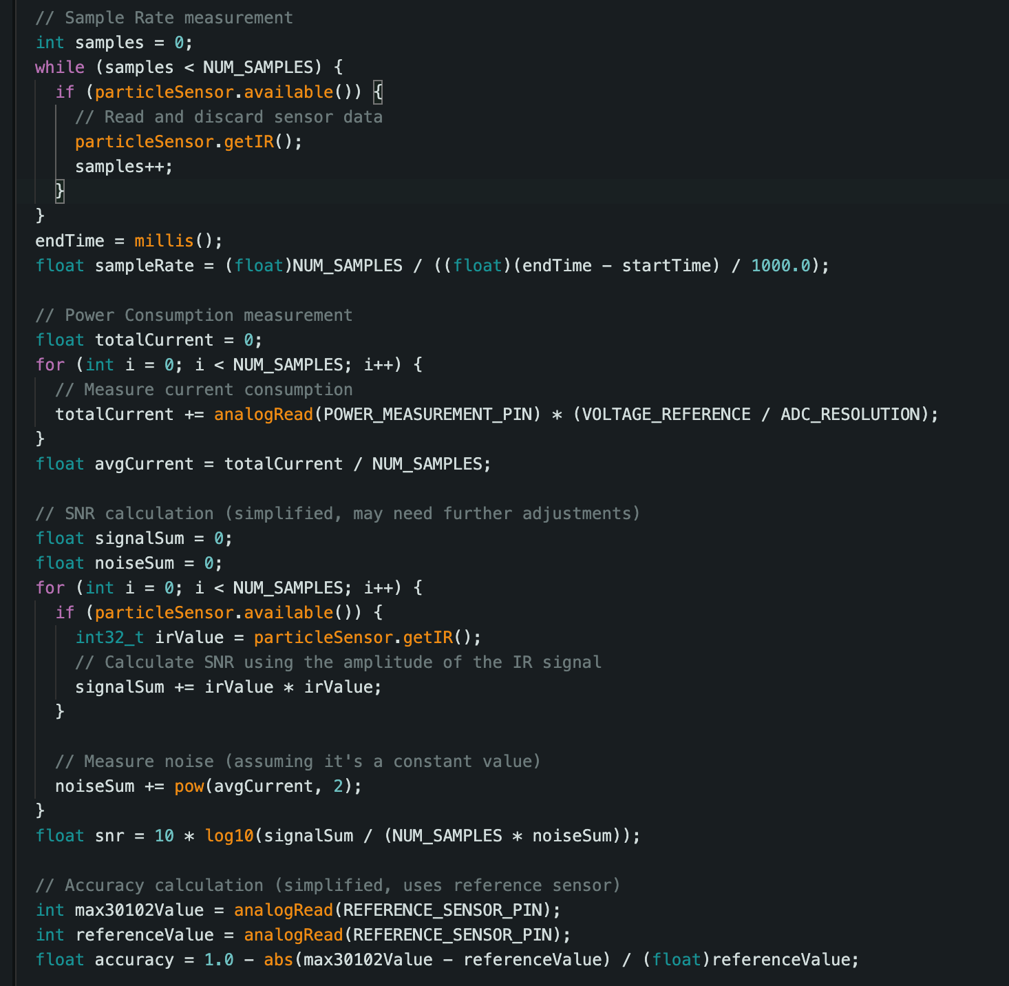
SENSOR ANALYZING EXAMPLE CODE FOR MAX30102
IT20037338 | JAYATHILAKE S. M. D. A. R | TMP_2023_139

Slide 30
MODULE ANALYZING
Feature | ESP32 | ESP8266 | Winner
Micrcontroller | Dual-core Xtensa LX6 | Single-core Xtensa LX6 | ESP32
CPU Frequency | Up to 240 MHz | Up to 160 MHz | ESP32
Wi-Fi Standard | 802.11b/g/n (2.4 GHz) | 802.11b/g/n (2.4 GHz) | Tie
Bluetooth | Built-in (BLE) | No | ESP32
RAM | 520 KB SRAM | 160 KB SRAM | ESP32
Flash Memory | 4 MB | 4 MB | Tie
Analog Inputs | 18 | 1 (10-bit) | ESP32
Low Power Modes | Yes | Yes | Tie
Cost | LKR 4950.00 | LKR 1650.00 | ESP8266
Wirelese Range (Wi-Fi) | Typically Better | Typically Good | ESP32
Real-Time Operating | FreeRTOS | No | ESP32
Ecosystem | Expanding | Established | ESP32
Community Support | Strong | Strong | Tie
Additional Features | Bluetooth, Dual-core | None | ESP32
IT20037338 | JAYATHILAKE S. M. D. A. R | TMP_2023_139

Slide 31
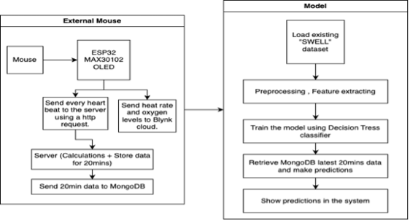
Workflow of the component
IT20037338 | JAYATHILAKE S. M. D. A. R | TMP_2023_139

Slide 32
Swell dataset
Dataset count – 410,323 rows
Extracted Features (Based on Correlation):
Standard Deviation of RR Intervals (SDRR)
Ratio of Standard Deviations (SDRR_RMSSD)
Standard Deviation of Differences of Adjacent RR Intervals (SD2)
Kurtosis of RR Intervals (KURT)
Skewness of RR Intervals (SKEW)
Median of Relative RR Intervals (MEDIAN_REL_RR)
Kurtosis of Relative RR Intervals (KURT_REL_RR)
Skewness of Relative RR Intervals (SKEW_REL_RR)
Very Low Frequency (VLF)
Percentage of VLF (VLF_PCT)
Total Power (TP)
Conditions
stress
no stress
interruption – Finish time reduced to 2/3
time pressure – Other tasks were assigned during the current task.
IT20037338 | JAYATHILAKE S. M. D. A. R | TMP_2023_139

Slide 33
METHODOLOGY
Let’s move to the code…
IT20037338 | JAYATHILAKE S. M. D. A. R | TMP_2023_139

Slide 34
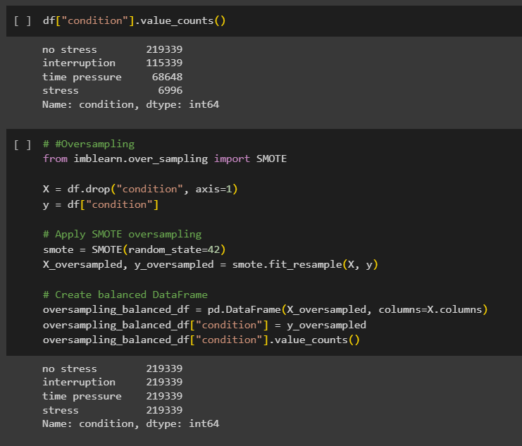
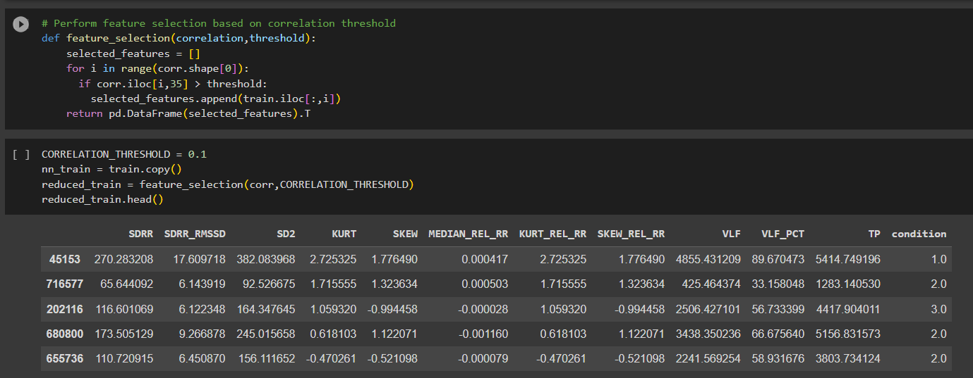
Results and discussion
Oversampling using smote – Balance THE dataset
Feature selection – correlation more than 0
IT20037338 | JAYATHILAKE S. M. D. A. R | TMP_2023_139

Slide 35
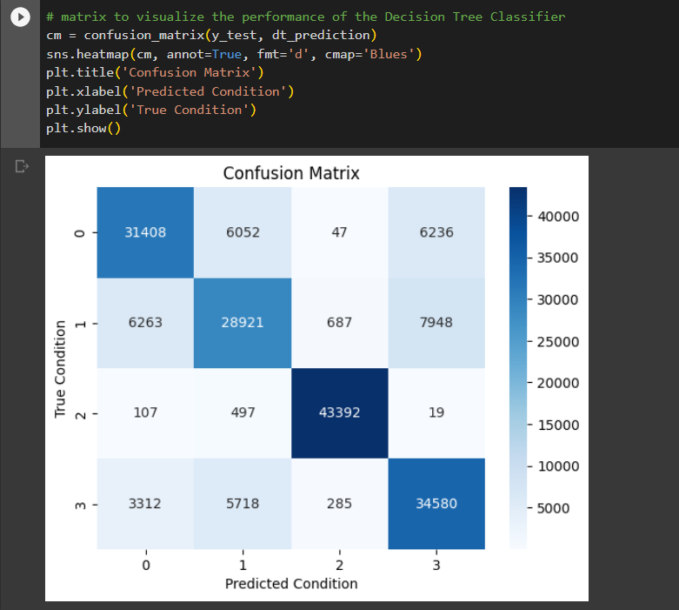
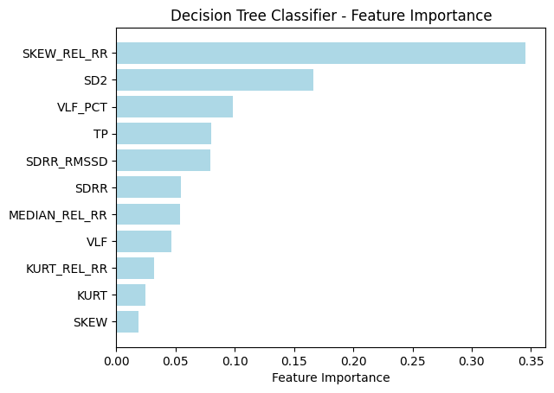
Results and discussion
PERFORMANCE OF THE DECISION TREE CLASSIFIER
IT20037338 | JAYATHILAKE S. M. D. A. R | TMP_2023_139

Slide 36
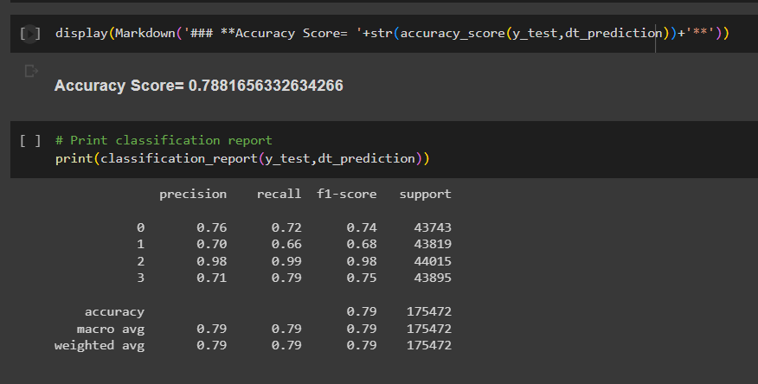
Results and discussion
DECISION TREE CLASSIFIER MODEL ACCURACY
IT20037338 | JAYATHILAKE S. M. D. A. R | TMP_2023_139

Slide 37
REFERENCES
[1] | Sun, D., Paredes, P., & Canny, J. (2014). MouStress: Detecting stress from mouse motion. In Conference on Human Factors in Computing Systems - Proceedings (pp. 61-70). Association for Computing Machinery. https://doi.org/10.1145/2556288.2557243
[2] | Contardi, U. A., Morikawa, M., Brunelli, B., & Thomaz, D. V. (2022). MAX30102 photometric biosensor coupled to ESP32-webserver capabilities for continuous point of care oxygen saturation and heartrate monitoring. Engineering Proceedings, 16(1). https://doi.org/10.3390/IECB2022-11114
[3] | Banholzer, N., Feuerriegel, S., Fleisch, E., Bauer, G. F., & Kowatsch, T. (2021). Computer mouse movements as an indicator of work stress: Longitudinal observational field study. Journal of Medical Internet Research, 23(4), e27121. https://doi.org/10.2196/27121
[4] | Lin, S. T., Chen, W. H., & Lin, Y. H. (2017). A pulse rate detection method for mouse application based on multi-PPG sensors. Sensors (Switzerland), 17(7), 1628. https://doi.org/10.3390/s17071628
IT20037338 | JAYATHILAKE S. M. D. A. R | TMP_2023_139

Slide 38
FACIAL DYNAMIC BASED EMOTION DETECTION

Slide 39
RESEARCH PROBLEM
Does using attention mechanisms with CNN lead to overfitting?
Will the attention weights focus on the irrelevant and noisy features?
How to design the attention mechanism to enhance the model's focus on relevant and informative features while reducing the influence of less relevant or noisy features.
PROPOSED SOLUTION
Train the model with attention mechanisms vs. without attention mechanisms.
Train the model with Spatial and Hierarchical attention mechanisms and use regular techniques that prevents overfitting
IT20037888 | RANASINGHE J. D | TMP_2023_139

Slide 40
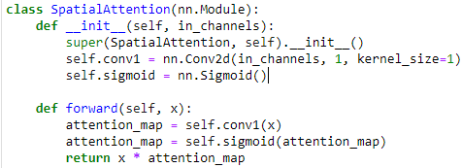
ATTENTION MECHANISMS
Spatial Attention Mechanism:
Designed to compute an attention map for each input feature map.
Apply 1x1 convolutional layer to the input feature maps.
Reduces the number of channels to 1 (Single-channel attention map for each feature map).
Sigmoid activation function [0, 1 range values].
IT20037888 | RANASINGHE J. D | TMP_2023_139

Slide 41
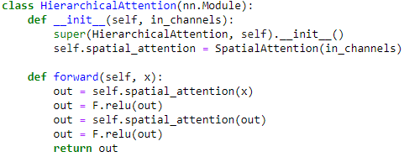
ATTENTION MECHANISMS
Hierarchical Attention Mechanism:
Hierarchical Attention class builds on the Spatial Attention mechanism.
It applies the Spatial Attention mechanism twice in succession.
First application --> ReLU activation Function
Spatial Attention mechanism is reapplied
IT20037888 | RANASINGHE J. D | TMP_2023_139

Slide 42
METHODOLOGY
Let’s move to the code…
IT20037888 | RANASINGHE J. D | TMP_2023_139

Slide 43
RESEARCH PAPER
PAPER TITLE:
Dynamic Attention Weighting Strategies for Enhancing Facial Dynamics-Based Stress Detection
CONFERENCES PUBLISHED IN:
5TH INTERNATIONAL CONFERENCE ON ADVANCEMENTS IN COMPUTING (ICAC 2023)
INTERNATIONAL CONFERENCE IN DATA SCIENCE (ICDS 2023)
IT20037888 | RANASINGHE J. D | TMP_2023_139

Slide 44
Progress Presentation 1 – 50%
CNN MODEL
VIT MODEL
APPLICATION
LITERATURE
ATTENTION MECHANISM WITH CNN
ATTENTION MECHANISM WITH VIT
APP INTEGRATION
RESEARCH PAPER
0%
50%
90%
100%
IT20037888 | RANASINGHE J. D | TMP_2023_139

Slide 45
Progress Presentation 2 – 95%
CNN MODEL
VIT MODEL
APPLICATION
LITERATURE
ATTENTION MECHANISM WITH CNN
ATTENTION MECHANISM WITH VIT
APP INTEGRATION
RESEARCH PAPER
0%
50%
90%
100%
95%
IT20037888 | RANASINGHE J. D | TMP_2023_139

Slide 46
REINFORCEMENT LEARNING BASED RECOMMENDATION SYSTEM

Slide 47
Background and literature
The recommendation problem was initially viewed as a classification or prediction issue, but it is now widely accepted that framing it as a sequential decision problem better captures user-system interactions [1].
RL is the de facto standard ML approach for addressing sequential decision problems [2].
Unlike traditional recommendation methods, including collaborative filtering and content-based filtering, RL can handle the sequential, dynamic user-system interaction and to consider the long-term user engagement. [1]
it was not very practical, mainly because of scalability problems of traditional RL algorithms
Solution – Function Approximation methods (like DRL) [1].
Multiple long-term objectives to be optimized – use MORL [4]
Single policy vs Multi policy MORL
Slate Recommendations – SlateQ [3]
IT20274702 | BARTHOLOMEUSZ S. V | TMP_2023_139

Slide 48
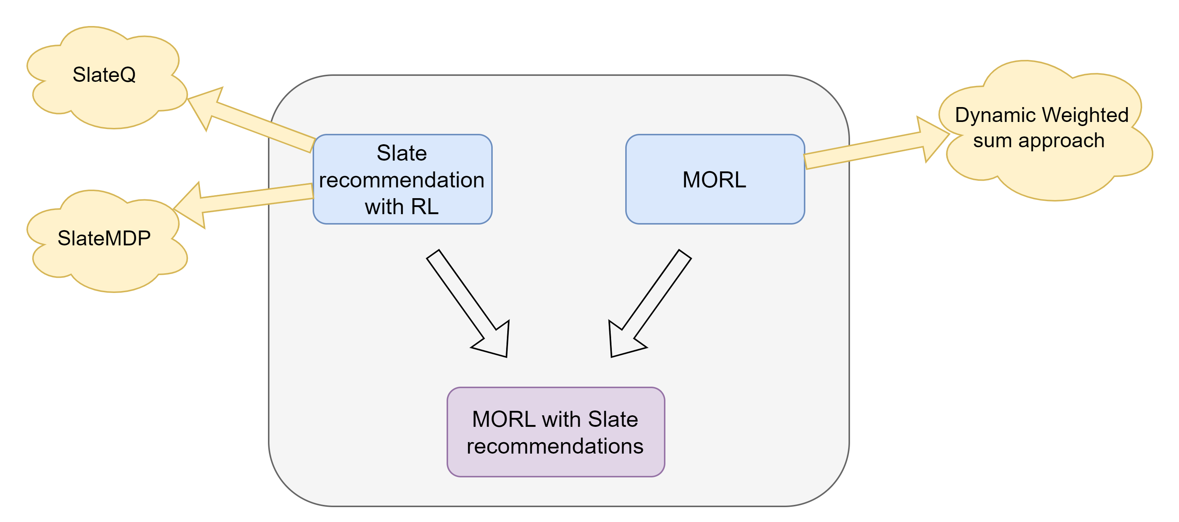
RESEARCH PROBLEM
Build a scalable stress relieving and emotion alleviation activities (slate recommendations) recommendation system which focus on long term user satisfaction.
How to evaluate online learning-based recommendation system?
PROPOSED SOLUTION
IT20274702 | BARTHOLOMEUSZ S. V | TMP_2023_139

Slide 49
Objectives
Collect / Develop stress relieving and emotion alleviation activities.
Focus on both stress relieving and emotion alleviation objectives (long term).
Recommend slate / list of activities.
Build a scalable recommendation system.
Develop simulations environments to evaluate the system
IT20274702 | BARTHOLOMEUSZ S. V | TMP_2023_139

Slide 50
Progress Presentation 1 – 50%
ACTIVITES
ALGORITHM
APP
LITERATURE
Develop Activities
RS Algorithm
APP INTEGRATION
RESEARCH PAPER
0%
50%
90%
100%
IT20274702 | BARTHOLOMEUSZ S. V | TMP_2023_139

Slide 51
Progress Presentation 2 – 90%
ACTIVITES
ALGORITHM
APP
LITERATURE
Develop Activities
RS Algorithm
APP INTEGRATION
RESEARCH PAPER
0%
50%
90%
100%
IT20274702 | BARTHOLOMEUSZ S. V | TMP_2023_139

Slide 52
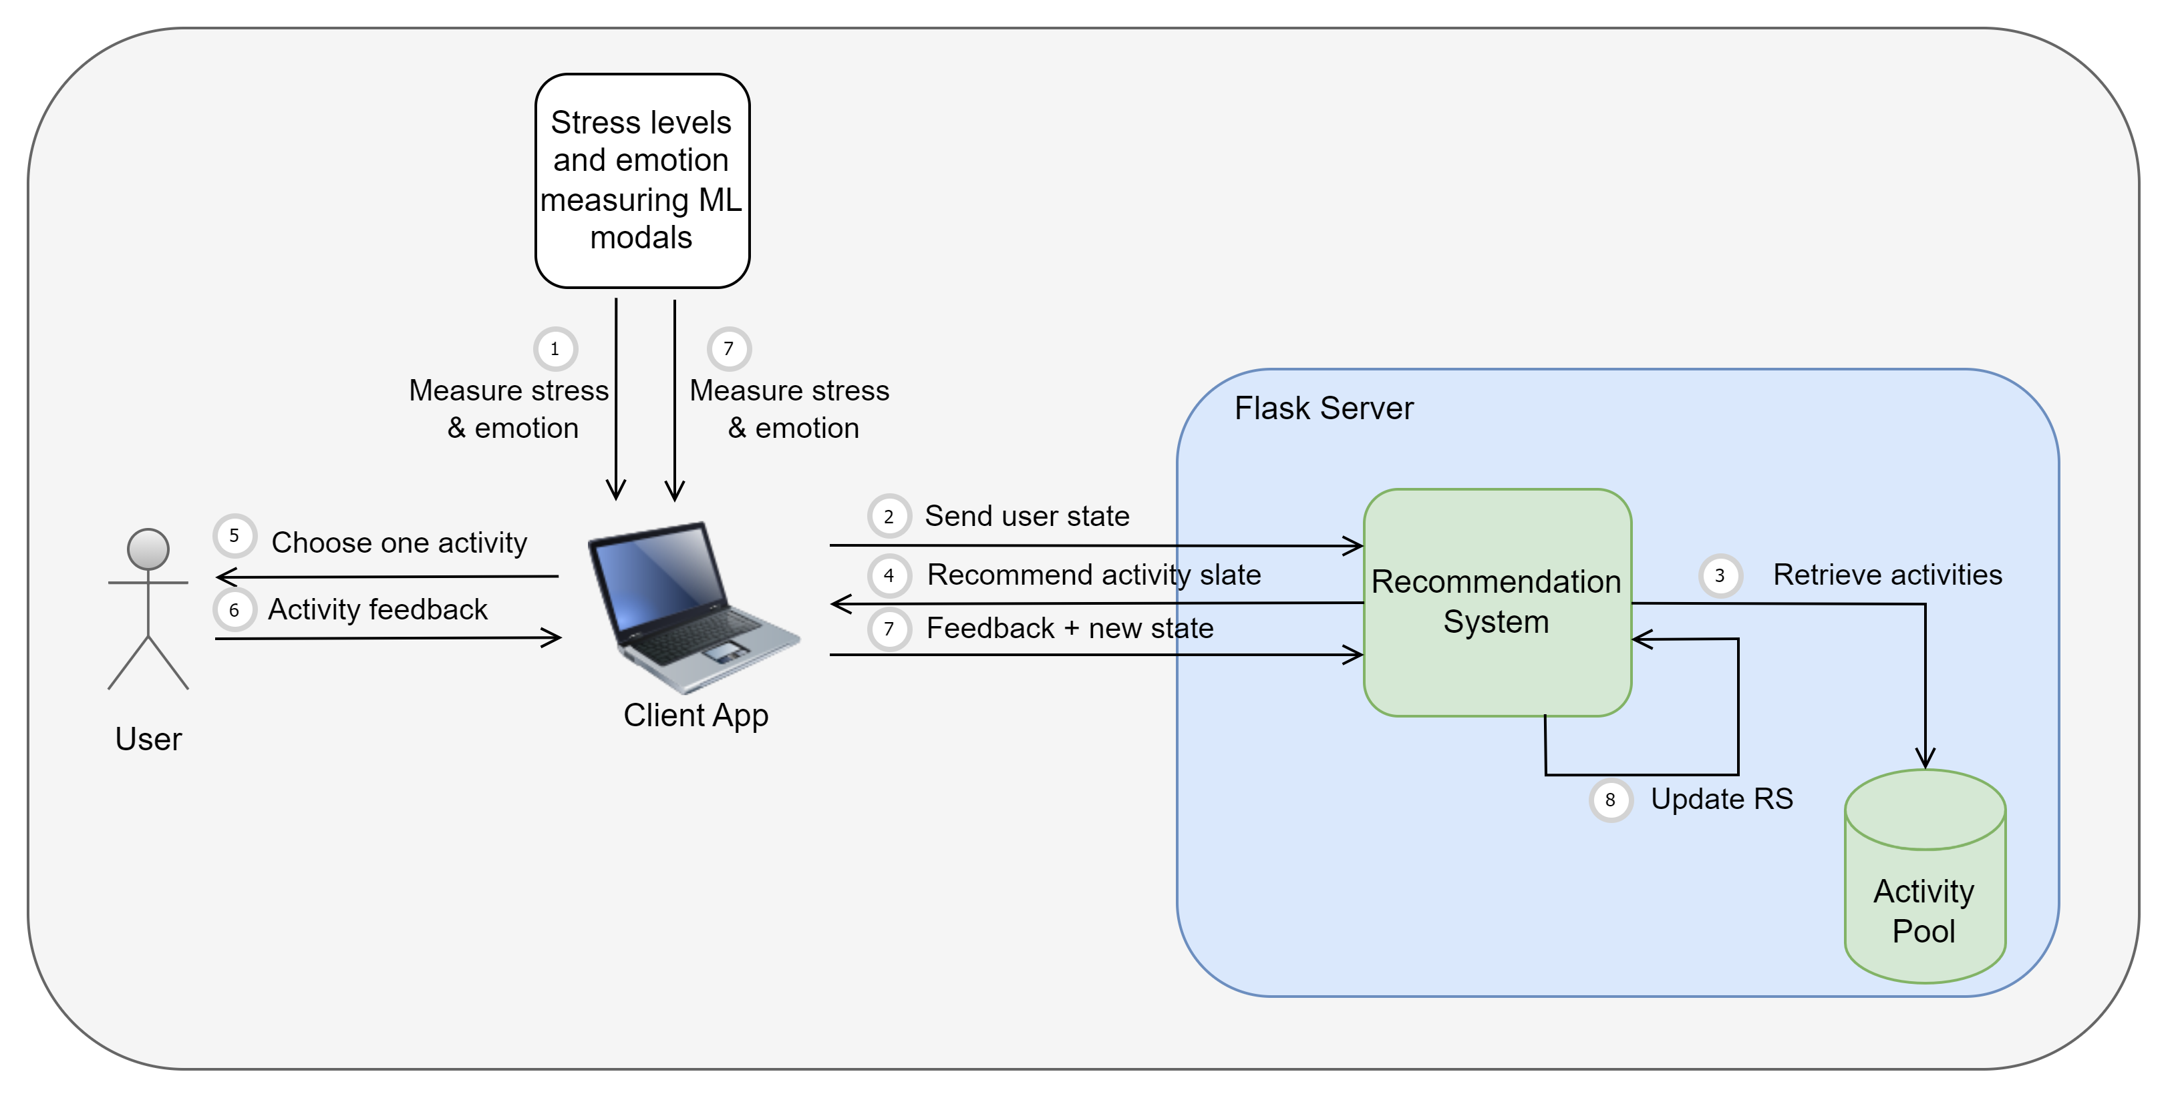
Workflow of the component
IT20274702 | BARTHOLOMEUSZ S. V | TMP_2023_139

Slide 53
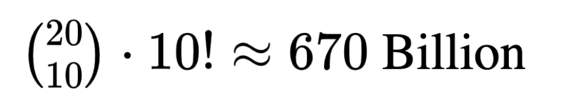
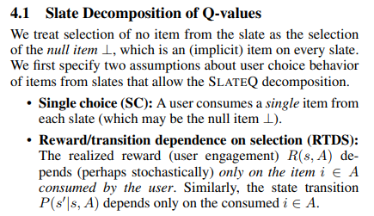
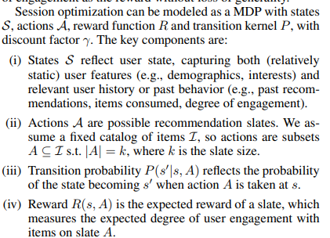
Methodology
Usage of SlateQ
Imagine we have 20 activities, and we are recommending slates of 10 activities at once,
Solution - SlateQ [3]
SlateQ – An algorithm that decomposes the LTV of a slate into its component wise LTVs [3]
IT20274702 | BARTHOLOMEUSZ S. V | TMP_2023_139

Slide 54
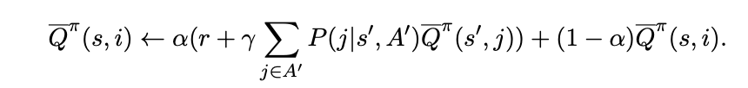
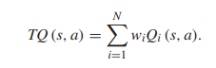
Methodology
Usage of SlateQ
SlateQ item-wise TD Update algorithm [3]
MORL – Weighted Sum Approach [4]
IT20274702 | BARTHOLOMEUSZ S. V | TMP_2023_139

Slide 55
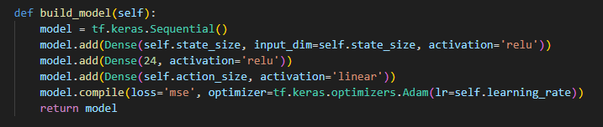
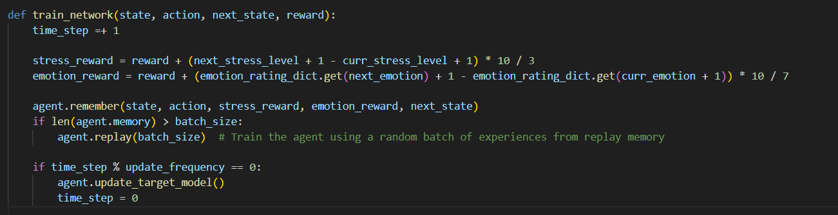
Methodology
Neural network
Train network
IT20274702 | BARTHOLOMEUSZ S. V | TMP_2023_139

Slide 56
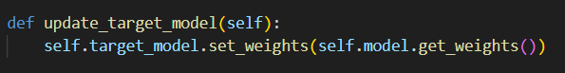
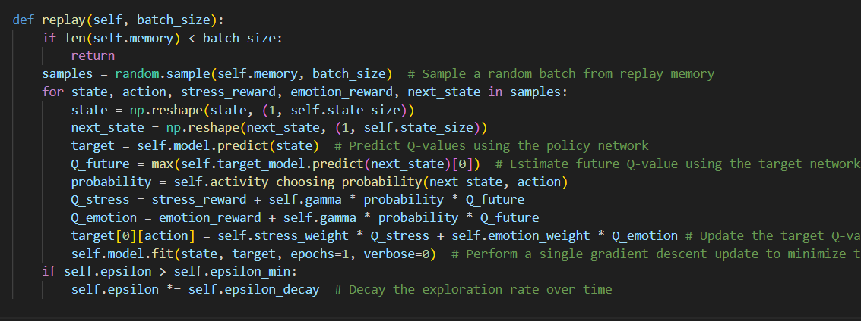
Methodology
Update target model
Store experiences in replay memory
Train network from random a sample from replay memory
IT20274702 | BARTHOLOMEUSZ S. V | TMP_2023_139

Slide 57
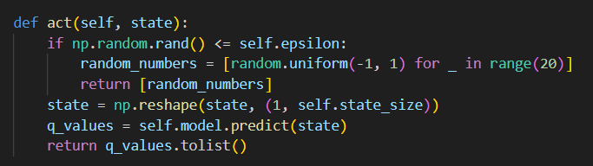
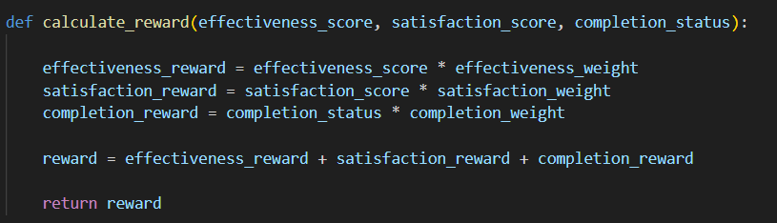
Methodology
Return actions along with Q values (activates)
Reward Calculation
IT20274702 | BARTHOLOMEUSZ S. V | TMP_2023_139

Slide 58
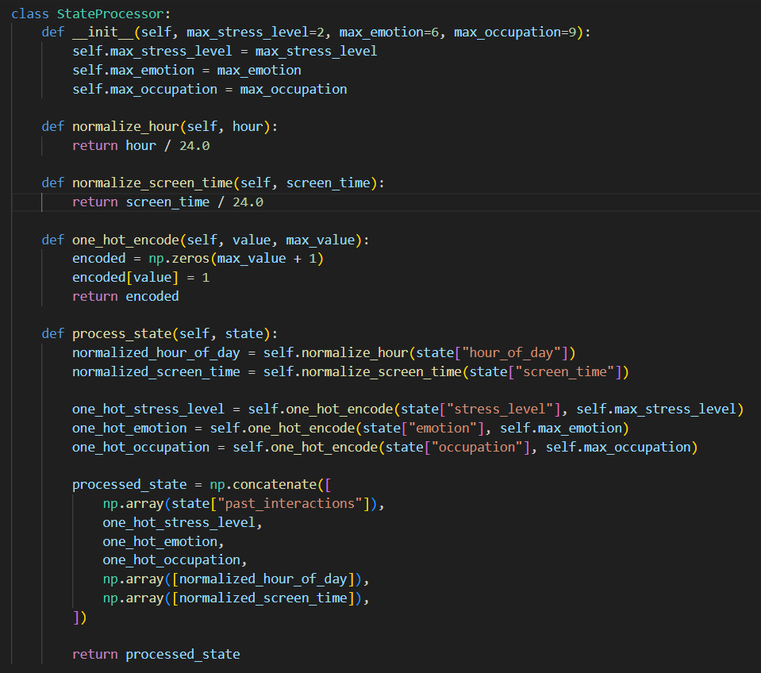
Methodology
State Preprocessor
IT20274702 | BARTHOLOMEUSZ S. V | TMP_2023_139

Slide 59
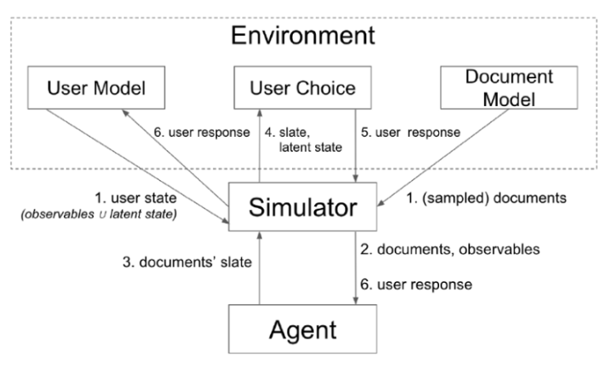
Evaluation
One major problem of evaluating sequential based, offline recommender settings, is lack of general-purpose simulation platforms [5].
Google’s RecSim framework - a configurable simulation platform for reinforcement learning recommender systems [5].
IT20274702 | BARTHOLOMEUSZ S. V | TMP_2023_139

Slide 60
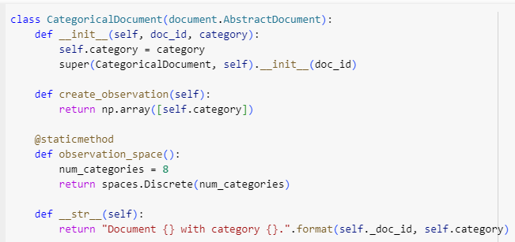
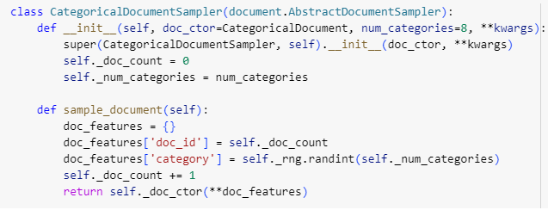
Evaluation
RecSim – Environment setup
Document Model
IT20274702 | BARTHOLOMEUSZ S. V | TMP_2023_139

Slide 61
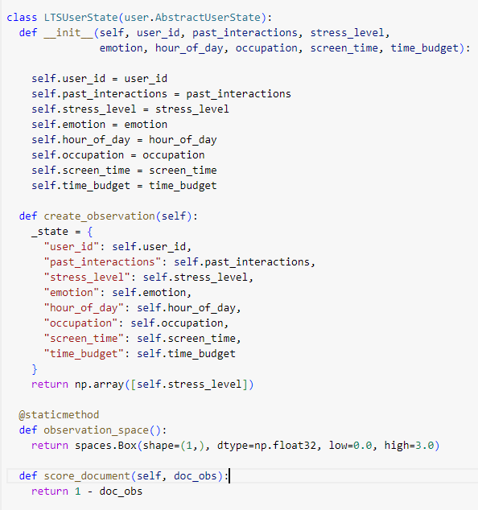
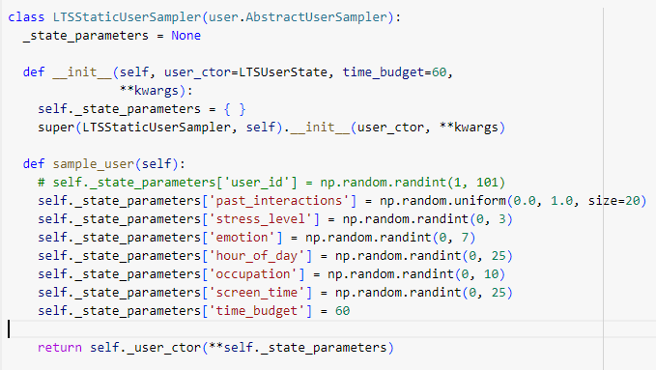
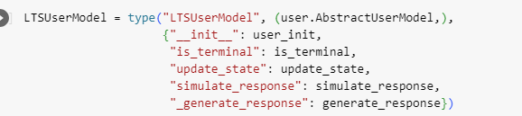
Evaluation
RecSim – Environment setup
User Model
IT20274702 | BARTHOLOMEUSZ S. V | TMP_2023_139

Slide 62
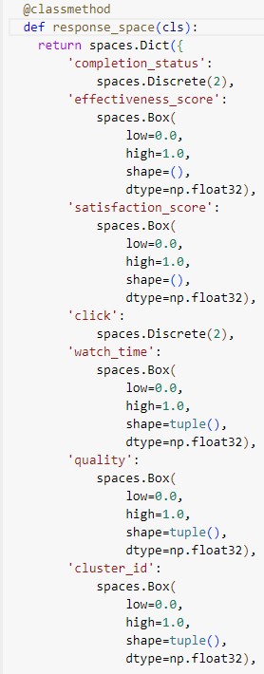
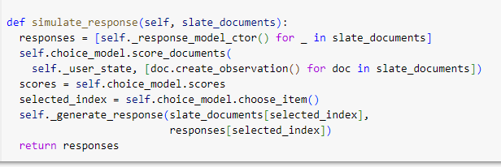
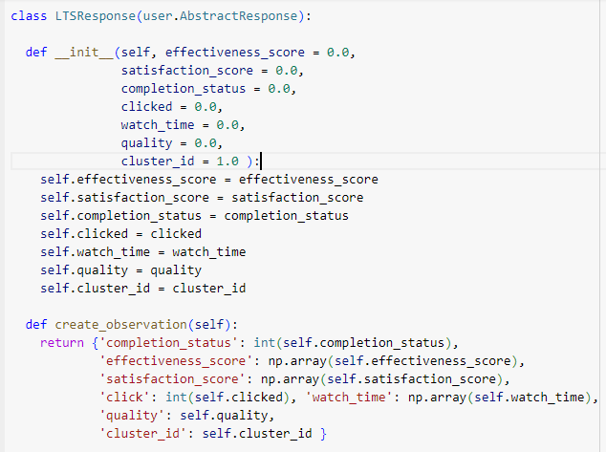
Evaluation
RecSim – Environment setup
User Response
IT20274702 | BARTHOLOMEUSZ S. V | TMP_2023_139

Slide 63
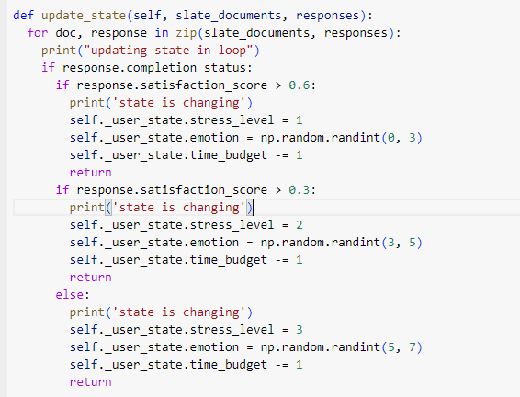
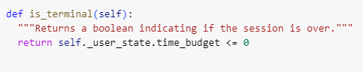
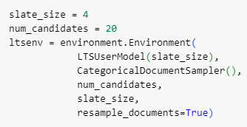
Evaluation
RecSim – Environment setup
State Updates
Env congif
IT20274702 | BARTHOLOMEUSZ S. V | TMP_2023_139

Slide 64
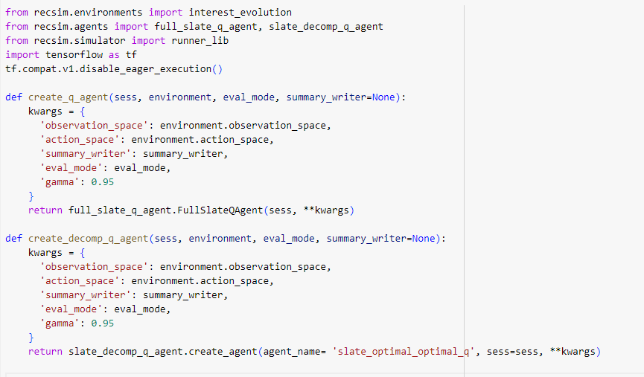
Evaluation
RecSim – Agent setup
IT20274702 | BARTHOLOMEUSZ S. V | TMP_2023_139

Slide 65




Evaluation
RecSim – Running experiments
Our agent
DQN agent
IT20274702 | BARTHOLOMEUSZ S. V | TMP_2023_139

Slide 66




Challenges
RecSim – Unable to pass a custom network to the framework
IT20274702 | BARTHOLOMEUSZ S. V | TMP_2023_139

Slide 67
REFERENCES
[1] | M. Mehdi Afsar, Trafford Crump, and Behrouz Far. 2022. Reinforcement Learning based Recommender Systems: A Survey. ACM Comput. Surv. 55, 7, Article 145 (July 2023), 38 pages. https://doi.org/10.1145/3543846
[2] | R. Chen, Q. Hua, Y. S. Chang, B. Wang, L. Zhang and X. Kong, "A Survey of Collaborative Filtering-Based Recommender Systems: From Traditional Methods to Hybrid Methods Based on Social Networks," IEEE Access, vol. 6, pp. 64301-64320, 2018.
[3] | E. Le and e. al, "Reinforcement learning for slate-based recommender systems: A tractable decomposition and practical methodology.," arXiv preprint arXiv:1905.12767, 2019.
[4] | C. Liu, X. Xu and D. Hu, "Multiobjective Reinforcement Learning: A Comprehensive Overview," in IEEE Transactions on Systems, Man, and Cybernetics: Systems, 2015
[5] | E. Ie, C. W. Hsu, M. Mladenov, V. Jain, S. Narvekar, J. Wang and C. Boutilier, "Recsim: A configurable simulation platform for recommender systems," arXiv preprint arXiv:1909.04847, 2019
IT20274702 | BARTHOLOMEUSZ S. V | TMP_2023_139

Slide 68
Hypothesis
The 3 prediction results (Keystroke Dynamic based stress prediction, HRV based stress prediction and the Facial Dynamics based Emotion prediction) that were generated during the same 20 minute session will be aggregated and output an Aggregated Stress Level.
As per the discussion conducted with the External Supervisor Mrs. Arosha Dassanayake we came up with the following hypothesis,
We will not be dealing with Clinical Stress.
Measure the stress level on a scale of 1 to 10
Neutral (not stressed): 1 – 2
Slightly Stressed: 3 – 4
Stressed: 5 – 7
Very Stressed: 8 – 10
Assign the values to the combinations received from the 3 components.
Eg: The combination,
Slightly_Stressed – Stress – Angry would be considered as a Stress value of 9 on the scale.
Therefore, the aggregated stress level would be Very Stressed
Based on the time and resource limitations the above hypothesis was used in Aggregating the Stress Level
TMP_2023_139

Slide 69
Hypothesis
As per the discussion conducted with the External Supervisor Mrs. Arosha Dassanayake we came up with the following hypothesis,
We rated 7 basic emotions on a scale of 1 to 10 based on how positive (good) they are
Anger: 3
Contempt: 1
Fear: 4
Disgust: 2
Happiness: 9
Sadness: 5
Surprise: 7
TMP_2023_139

Slide 70


Hypothesis
As per the discussion conducted with the External Supervisor Mrs. Arosha Dassanayake we came up with the following hypothesis,
Gathering data to get activity choosing probabilities of users in different states.
TMP_2023_139

Slide 71

Developed solution
TMP_2023_139

Slide 72


NBQSA
NOMINATED AND SELECTED FOR THE NBQSA COMPETITION.
COMPETED UP TO THE FINAL ROUND 1 WHICH WAS HELD AT IIT
TMP_2023_139

Slide 73
demonstration
THE DEMONSTRATION OF THE DEV RELAX DESKTOP APPLICATION FUNCTIONALITY

Slide 74

COMMERCIALIZATION
Phase 1 – Launching the first version of the software and installing it at Xinotech Technology and services company.
Phase 2 – We are launching a free version of our software with a limited number of activities, and a professional version with unlocked full features that require a subscription. Our target clients are IT/Software companies who will benefit from the advanced capabilities of the pro version.
DevRelax

Slide 75
thank YOU!

